Slide 1

BUS Architecture of Microprocessor

Slide 2
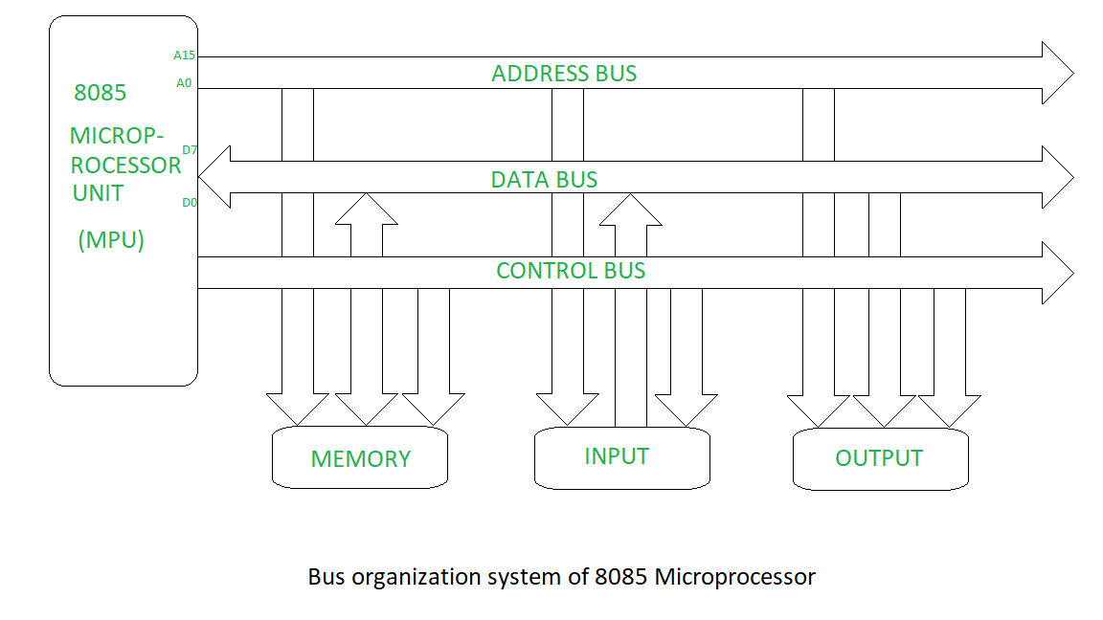









Slide 3



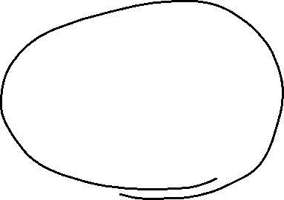










Bus
Bus is a group of conducting wires which carries information, all the peripherals are connected to microprocessor through Bus.
There are three types of buses in 8085:
Address Bus
Data Bus
Control Bus
System Bus

Slide 4
Address Bus
It is a group of conducting wires which carries address only.
Address bus is unidirectional because data flow in one direction, from microprocessor to memory or from microprocessor to Input/output devices (That is, Out of Microprocessor).
Length of Address Bus of 8085 microprocessor is 16 Bit (That is, Four Hexadecimal Digits), ranging from 0000 H to FFFF H, (H denotes Hexadecimal).
The microprocessor 8085 can transfer maximum 16-bit address which means it can address 65, 536 different memory location.
The Length of the address bus determines the amount of memory a system can address.

Slide 5
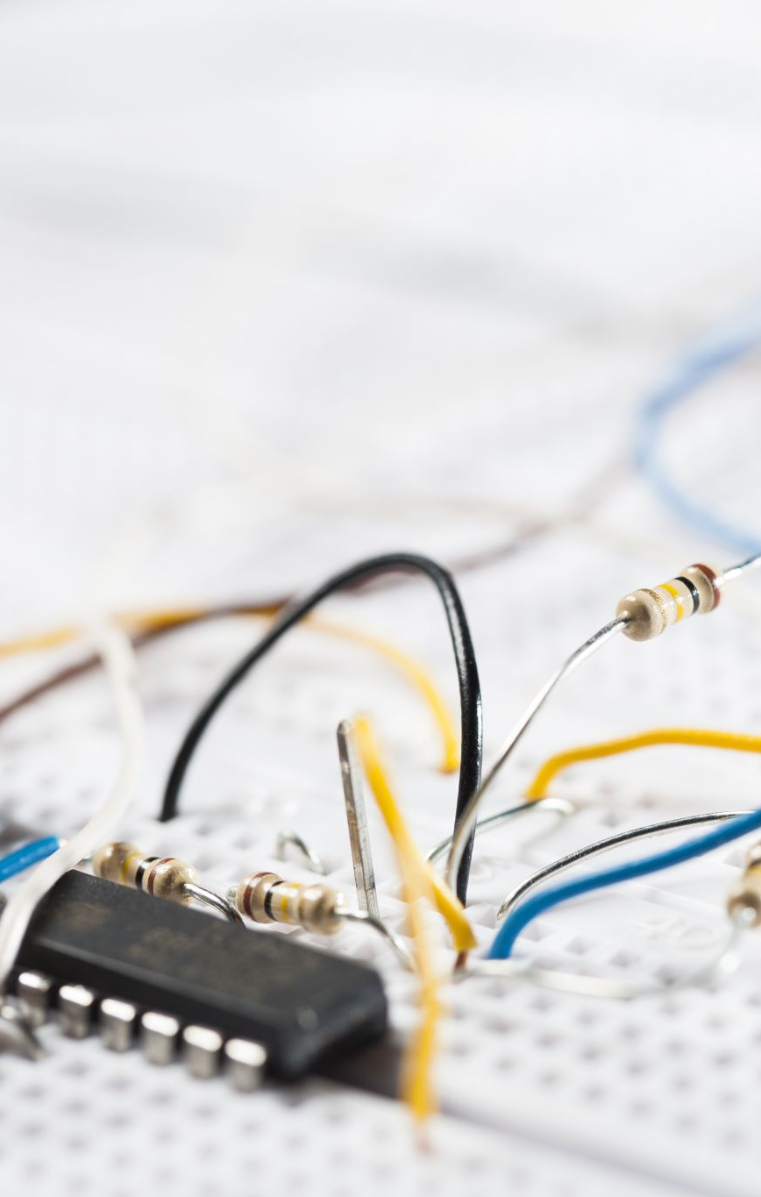
DatA Bus
It is a group of conducting wires which carries Data only.
Data bus is bidirectional because data flow in both directions, from microprocessor to memory or Input/Output devices and from memory or Input/Output devices to microprocessor.
Length of Data Bus of 8085 microprocessor is 8 Bit (That is, two Hexadecimal Digits), ranging from 00 H to FF H. (H denotes Hexadecimal).
When it is write operation, the processor will put the data (to be written) on the data bus, when it is read operation, the memory controller will get the data from specific memory block and put it into the data bus.
The width of the data bus is directly related to the largest number that the bus can carry, such as an 8-bit bus can represent 2 to the power of 8 unique values, this equates to the number 0 to 255.

Slide 6










Control Bus
It is a group of conducting wires, which is used to generate timing and control signals to control all the associated peripherals, microprocessor uses control bus to process data, that is what to do with selected memory location. Some control signals are:
Memory read
Memory write
I/O read
I/O Write
Opcode fetch
One line of control bus may be the read/write line.
If the wire is low (no electricity flowing) then the memory is read, if the wire is high (electricity is flowing) then the memory is written.

Slide 7
Q1 A certain memory has a capacity of 4K × 8.
(a) How many data input and data output lines does it have?
(b) How many address lines does it have?
(c) What is its capacity in bytes?
Sol: (a) Eight of each because the word size is eight.
(b) The memory stores 4K = 4 × 1024 = 4096 words. Thus, there are 4096 memory addresses. Because 4096 = 2^{12}, it requires a 12-bit address code to specify one of 4096 addresses.
(c) A byte is eight bits. This memory has a capacity of 4096 bytes.
Q2. How many address and data lines are exists in 8Mx16?
Sol: Memory Capacity = 2^{AL}, where AL = Address Lines
8M = 2^{AL}
2³x2²⁰ = 2^{AL}
2²³ = 2^{AL}
AL = 23
Data Lines = 16

